Slide 1
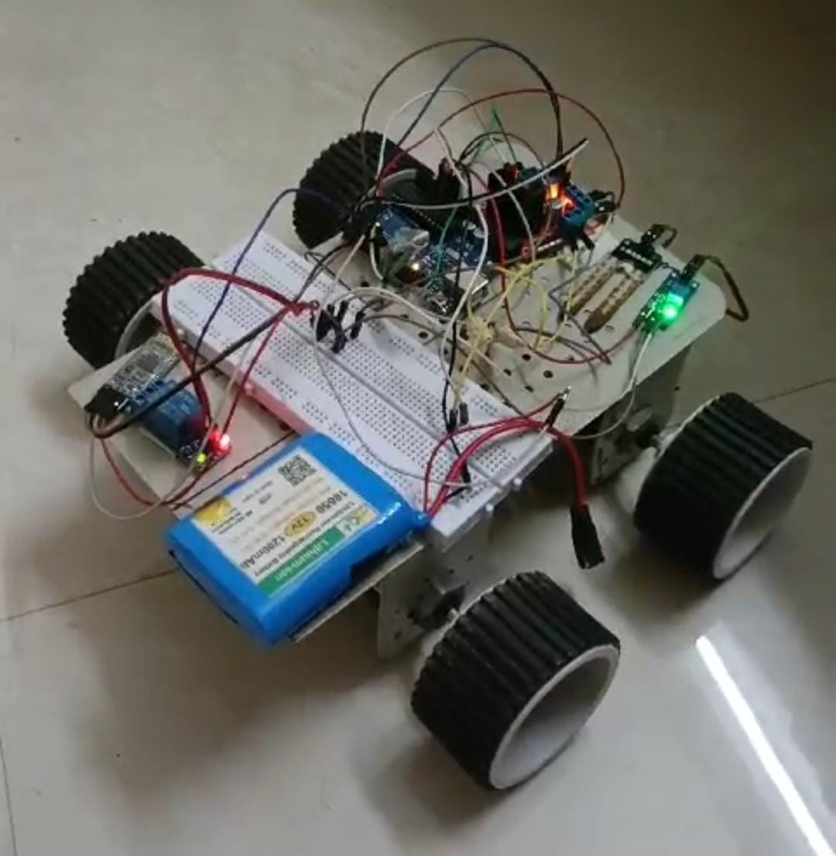
Agricultural Robot
Using Arduino
By-
M.Thirumalesh
J.krishna
D.Pragati Dhanraj
B.Vikram
Jayshree uikey
N.Pravalika
B.Sai Sandeep naik
B.Janani

Slide 2
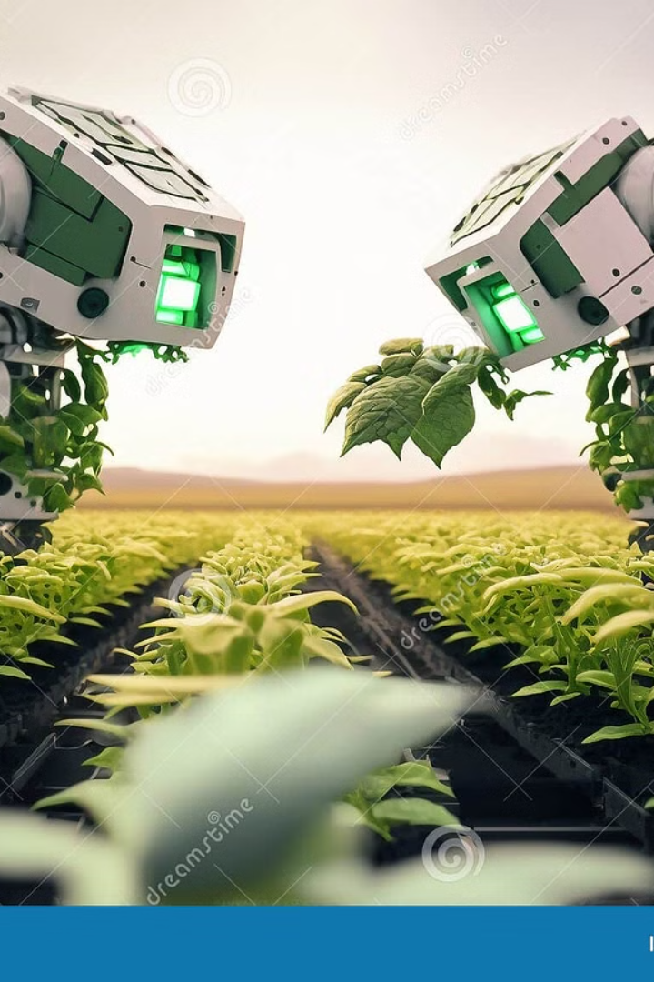
Introduction to Agricultural Robot
Agricultural robotics is a rapidly evolving field that is transforming the way we approach farming and food production. These advanced machines are designed to automate various tasks, from seeding and weeding to spraying and moisture sensing, helping farmers become more efficient and sustainable.

Slide 3
Components:
1.Dc gear motor(150 rpm) 10.ARDUINO UNO R3(ATmega328)
2.Clamp L 11.7805 Voltage regulator
3.L298N Motor driver 12. Moisture sensor
4.Servo motor SG 90 180
5.Servo motor MG90S
6.Dc motor for weeding(100 rpm)
7.HC-05 Bluetooth module
8.Water pump and relay 5v
9.Battery

Slide 4
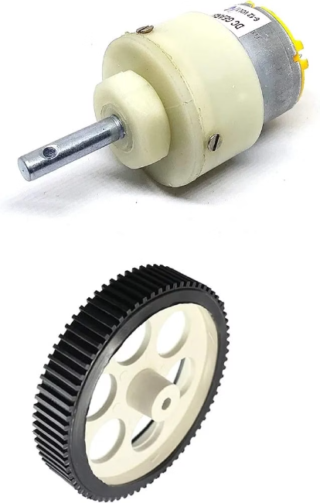
Dc gear motor(150 rpm)
A gear motor is a type of electric motor that incorporates
a gear train for reducing the speed of the motor and increasing
the torque output.
The gear motor 150rpm is specifically designed
to rotate at a speed of 150 revolutions per minute.
It is commonly used in various applications that require
precise speed control and high torque output,such as robotics,
automation, and machinery.

Slide 5
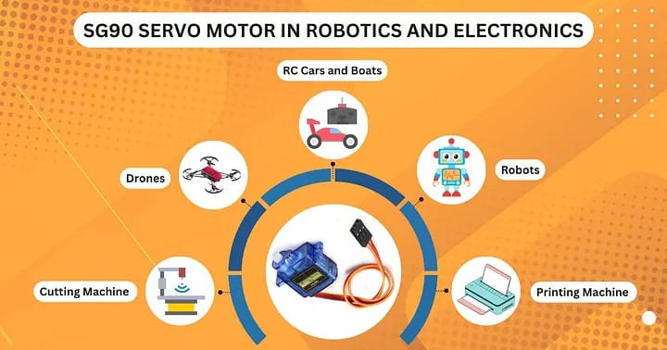
Servo motor SG 90 180
The SG90 and SG180 are popular servo motors
commonly used in robotics and automation
projects.
They are compact and lightweight, making them
ideal for applications where space is limited.
SG 90 servo can rotate approximately 180
degrees (90 in each direction) and works just
like the standard kinds but smaller. It will fit in
smaller .It comes with 3 horns (arms) and
hardware.

Slide 6
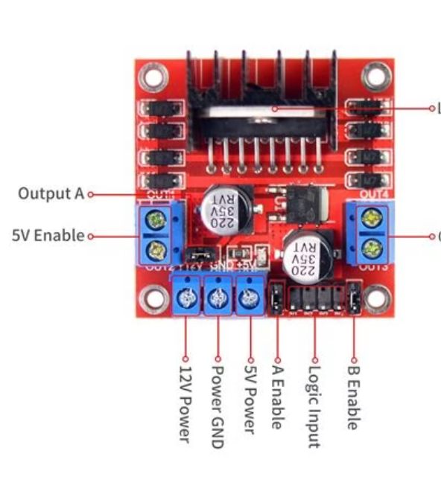
L298N Motor driver
The L298N motor drive is a popular dual H-bridge motor
driver module that allows you to control the direction
and speed of two DC motors.
It is commonly used in robotics and automation projects
that require precise motor control.
The L298N module can handle a maximum current
of 2A per channel and can be controlled using
digital inputs.

Slide 7
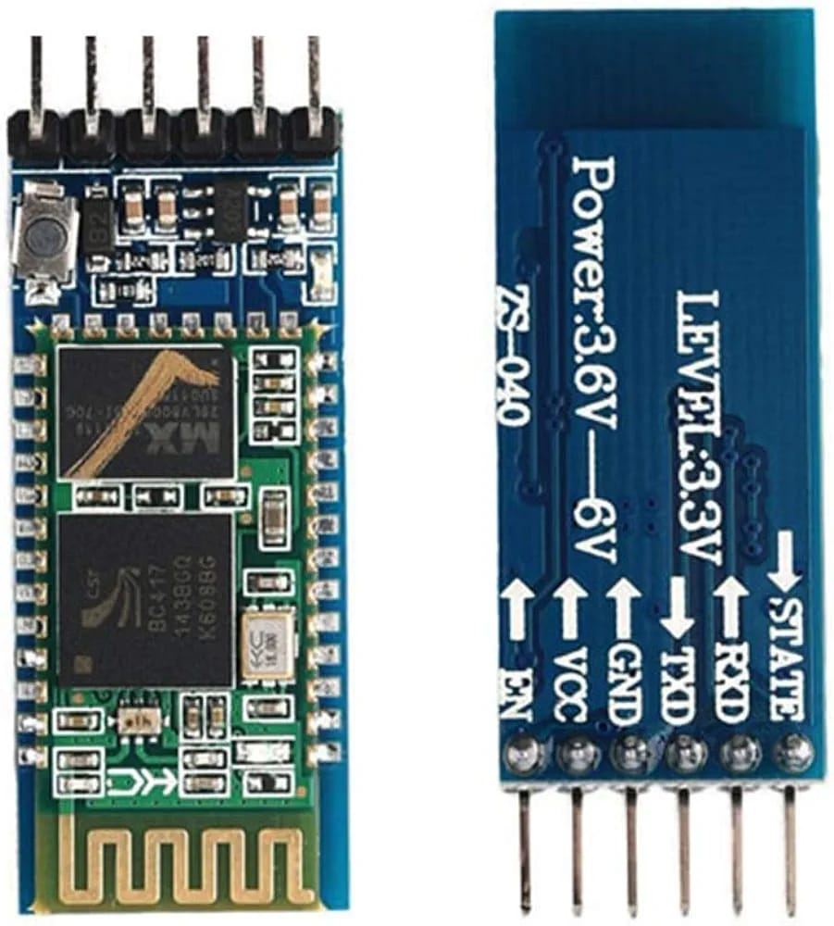
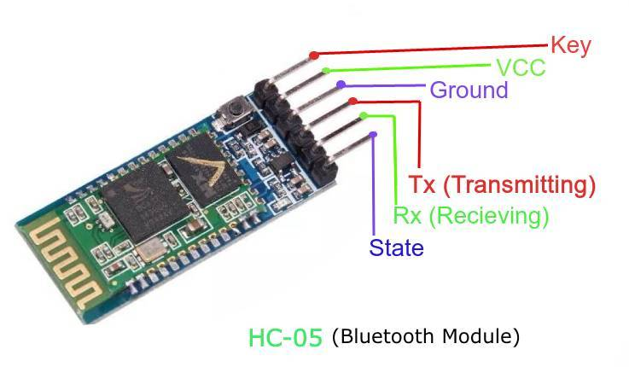
HC-05 Bluetooth module
The Bluetooth module is a wireless communication
device that allows robots to connect and communicate
with other devices, such as smartphones, tablets,
or computers.
It enables remote control and data exchange
between the robot and the user, facilitating various
applications in agricultural robotics.
Bluetooth Version: 2.0+EDR (Enhanced Data Rate) Operating
Voltage: 3.3V. Communication Interface: UART/TTL
Operating Frequency: 2.4GHz ISM band. Transmission Range: Up to 10 meters.
Dimensions: 26.9 x 13 x 2.2 mm. Weight: 5 Grams.

Slide 8
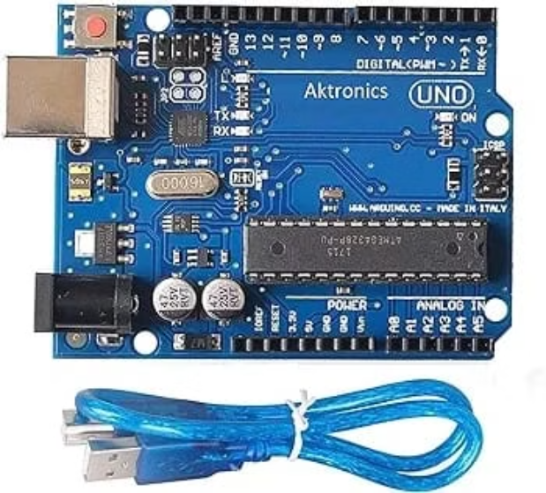
ARDUINO UNO R3(ATmega328)
The Arduino Uno is a popular microcontroller board widely used in robotics and electronics projects.
It offers a wide range of input and output pins, allowing
you to connect and control different devices such as
sensors, motors, and displays.
It contains everything needed to support the
microcontroller; simply connect it to a computer with
a USB cable or power it with a AC to DC adapter
or battery to get started.
Digital I/O Pins: 14 (of which 6 provide PWM output)
Flash Memory: 32 KB (ATmega328P) of which 0.5 KB
used by bootloader. SRAM: 2 KB (ATmega328P), Operating
Voltage 5V

Slide 9
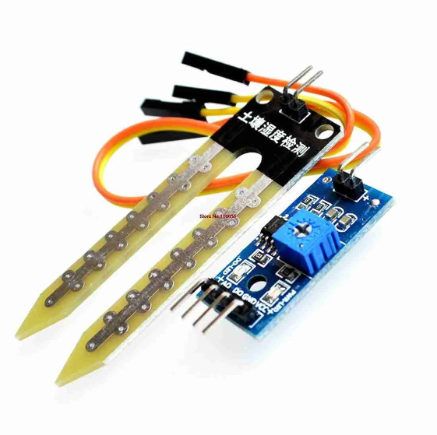
Moisture sensor(LM393)
The moisture sensor LM393 is a commonly used sensor
in agricultural applications to measure the moisture
content in the soil. It is based on the LM393 voltage
comparator chip, which provides a digital output based
on the moisture level.
The sensor consists of two probes that are inserted into
the soil. When the soil moisture level reaches a certain,
the sensor outputs a high signal, indicating that the soil
is wet.
Conversely, when the moisture level drops below the
threshold, the sensor outputs a low signal, indicating that
the soil is dry.
With the LM393 moisture sensor, you can optimize water usage, prevent overwatering or underwatering, and promote healthier plant growth in agricultural projects

Slide 10
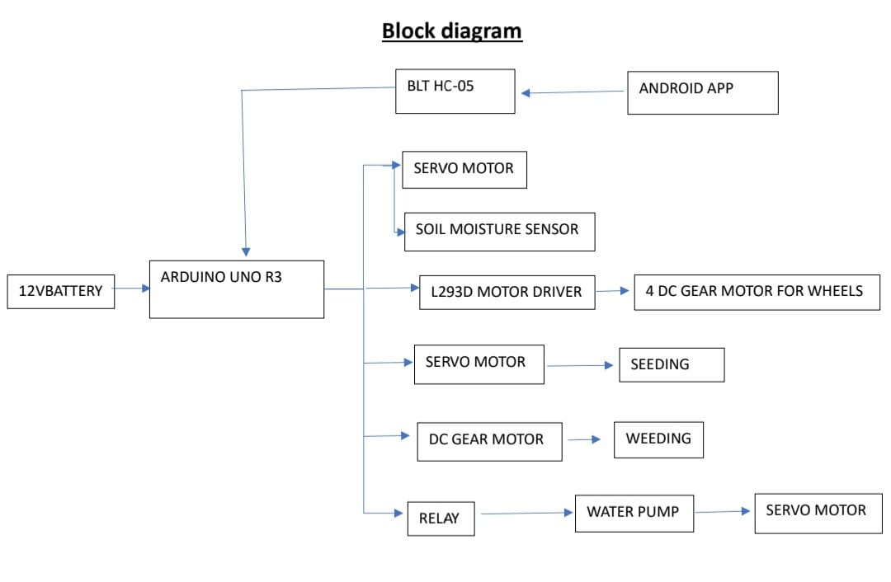

Slide 11
Functions of Agricultural Robots
Seeding
Weeding
Spraying
Precision seeding robots can plant seeds at the optimal depth and spacing, ensuring even germination and maximizing crop yields.
Autonomous weeding robots use computer vision and mechanical tools to identify and remove unwanted plants, reducing manual labor and chemical usage.
Robotic sprayers can apply pesticides, herbicides, and fertilizers with pinpoint accuracy, minimizing waste and environmental impact.

Slide 12
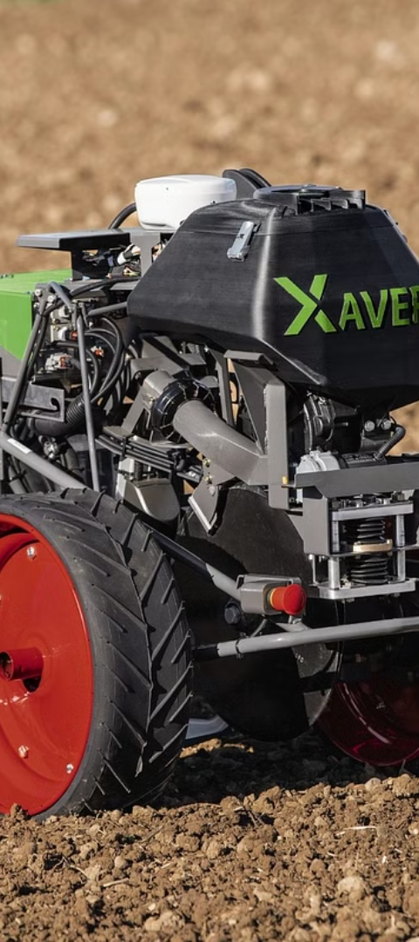
Seeding Mechanism
1
Seed Metering
Robotic seeders use precise seed metering mechanisms to dispense individual seeds at the desired rate and spacing.
2
Seed Placement
Advanced robotic arms and planting tools ensure each seed is deposited at the optimal depth and location for maximum germination.
3
Seed spacing Adjustment
Agricultural robots can also incorporate soil preparation tasks, such as tilling and leveling, to create the ideal conditions for seed germination.

Slide 13
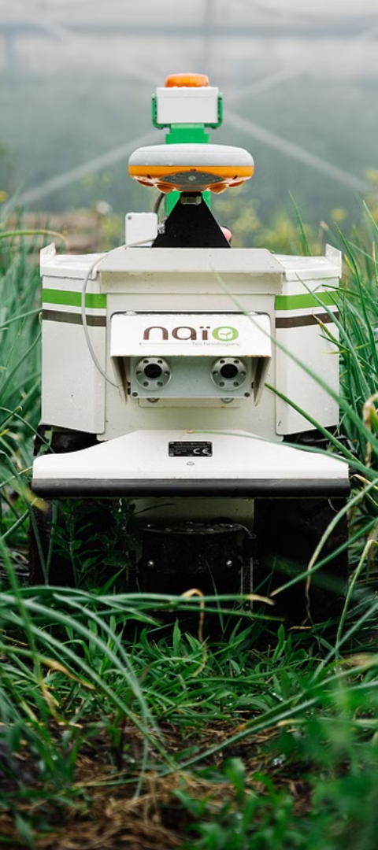
Weeding Automation
1
Computer Vision
2
Mechanical Removal
Robotic weeders use advanced computer vision algorithms to identify and distinguish weeds from crop plants.
Robotic arms equipped with mechanical tools can selectively remove weeds without damaging the desired crops.
3
Precision Targeting
Robotic weeders can navigate through fields and precisely target individual weeds, minimizing collateral damage.

Slide 14
Spraying System
Targeted Application
Autonomous Navigation
Robotic sprayers can precisely target specific plants or areas, reducing chemical waste and environmental impact.
These robots can navigate through fields autonomously, following pre-programmed routes or responding to real-time sensor data.
Reduced Labor Intensity
Improved Safety
Robotic sprayers can reduce the need for manual labor in spraying operations, saving time and resources.
Robotic sprayers eliminate the need for humans to be exposed to potentially harmful chemicals during spraying.

Slide 15




Moisture Sensing with Arduino
Soil Moisture
Temperature
Humidity
Weather Integration
Arduino-based soil moisture sensors can continuously monitor the water content in the soil, providing real-time data to optimize irrigation.
Integrated temperature sensors can help determine the optimal growing conditions for specific crops and trigger adjustments as needed.
Humidity sensors work alongside the moisture and temperature data to provide a comprehensive understanding of the microclimate.
The Arduino-based system can be connected to weather stations to correlate environmental conditions with soil data for optimal decision-making.

Slide 16
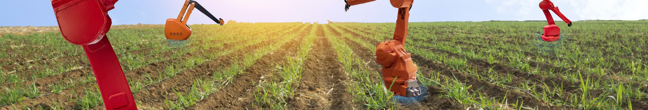




l
Advantages of Robotic Agriculture
$$4$$
Precision
Efficiency
Productivity cost effective
Robots can work quicker than Although the outlay could be
humans and for longer periods high,with robots running 24/7
without a reduction in these investments is quickly
productivity,risk of injury returned,as farms will be
or a need for breaks. Working more efficiently
With reduce waste ,reduce
labour and reduce running
costs.
Robotic systems can perform tasks with unparalleled accuracy and consistency, leading to improved crop yields and resource efficiency.
Automated robotic systems can work tirelessly, 24/7, without the need for breaks, leading to increased productivity.

Slide 17
Disadvantages
It requires one time higher investment.
Agricultural robots and other equipments are complex and requires training to be provided to farmers before use.
Agricultural robots require electricity. In rural areas, frequent power cuts hamper their popularity and usage.
Agricultural robots require complex algorithms to make it work for any task.
Agricultural robots require rigorous testing before they are installed at the site for any job.

Slide 18
Conclusion
The agricultural robot presents a promising solution to improve farming practices and increase productivity.
With its ability to automate tasks such as seeding, weeding, and spraying, it reduces manual labor and allows for more efficient resource utilization.
The integration of sensors, Arduino, motors, and other components enables precise control and monitoring of agricultural processes.
As technology continues to advance, we can expect even more advancements in robotic agriculture, such as improved autonomous navigation, data analysis, and integration with smart farming systems.
The future of agricultural robotics holds great potential in revolutionizing the way we cultivate crops and address the challenges of food production.

Slide 19


